Slide 1

BMS COLLEGE OF ENGINEERING
(Autonomous Institute, Affiliated to VTU, Belagavi)
DEPARTMENT OF MACHINE LEARNING
(UG Program: B.E. in Artificial Intelligence and Machine Learning)
Course : Python Programming
Course Code: 22AM4AEPPM
S.I.R.I.U.S
SEE PRESENTATION
Date: Oct. 11, 2023
Presented By,
Student Name & USN :
Pacharne Kaushal Yogesh - 1BM21AI080
Pranshu Arora - 1BM21AI091
Priyanshu Prasad - 1BM21AI096
Ryan Gupta - 1BM21AI107
Semester & Section: 4B
Project Batch No. : P16
Faculty In-Charge:
Dr. Seemanthini K Gowda
Assistant Professor
Department of Machine Learning
BMS College of Engineering

Slide 2
Agenda
Introduction
Problem Statement
Literature Review
Testing and Validation
Proposed Architecture
Open Issues
Functional and Non-Functional Requirements
Methodology
Progress in Project so far
Tools and Technology Used
Conclusion

Slide 3

INTRODUCTION
S.I.R.I.U.S. (Stock Intelligent Real-time Investment Understanding System) is a cutting-edge solution that leverages AI and data analysis to provide intelligent investment insights.
S.I.R.I.U.S. uses a variety of AI techniques, including machine learning, natural language processing, and sentiment analysis, to analyze vast amounts of data, including historical market data, news headlines, social media posts, and economic data. This data is used to identify patterns and trends that can be used to predict future stock prices and identify investment opportunities.
In addition to providing predictive insights, S.I.R.I.U.S. can also be used to assess risk, create personalized investment recommendations, and track the performance of investments. S.I.R.I.U.S. is a powerful tool that can help investors make more informed and profitable investment decisions.

Slide 4

INTRODUCTION
Artificial intelligence (AI) and machine learning (ML) are playing an increasingly important role in addressing the challenges and improving the accuracy of decision-making in a dynamic financial market environment.
Here are some of the ways in which AI and ML are being used in finance:
Predictive analytics: AI and ML can be used to analyze historical data to identify patterns and trends that can be used to predict future events, such as stock prices or interest rates.
Risk management: AI and ML can be used to identify and manage risks, such as the risk of default on a loan or the risk of a market crash.
Fraud detection: AI and ML can be used to detect fraudulent activity, such as credit card fraud or money laundering.
Customer service: AI and ML can be used to automate customer service tasks, such as answering questions and resolving problems.
Compliance: AI and ML can be used to help financial institutions comply with regulations, such as those governing anti-money laundering and insider trading.

Slide 5
Problem Statement
In the context of contemporary financial markets, where investment decisions are intricately linked to the rapidly evolving realm of artificial intelligence, there exists a critical need for innovative solutions that harness the power of machine learning and advanced data analysis. Prediction plays a very important role in stock market business which is a very complicated and challenging process. Employing traditional methods like fundamental and technical analysis may not ensure the reliability of the prediction. This report addresses the design and development of an AI-driven virtual assistant named S.I.R.I.U.S. (Stock Intelligent Real-time Investment Understanding System), poised to revolutionize the landscape of investment strategies. The objective of this research is to create a comprehensive, intelligent, and adaptable system capable of tackling multifaceted real-world investment challenges.

Slide 6
Literature review
TITLE / YEAR | AUTHOR | APPLIED METHODOLOGY | FINDINGS | LIMITATIONS
A Prediction Approach for Stock Market Volatility Based on Time Series Data 2019 | Sheikh Mohammad Idrees M. Afshar Alam | Time series ARIMA model | The predicted time series has been compared with the actual time series, which shows roughly a deviation of 5% mean percentage error for both Nifty and Sensex on average. | Simple time series, is not that powerful and accurate way to predict but ARIMA approach is good enough for handling time series data
Optimizing LSTM for time series prediction in Indian stock market 2019 | Anita Yadav C K Jha Aditi Sharan | Long Short Term Memory (LSTM) | The number of hidden layers was varied from one to seven. The results show that n = 1 appears to be the best configuration as far as mean RMSE is concerned. | Present work is limited to tuning the basic LSTM architecture as it has been performed on Google Colab which provides eight Tensor processing units (TPUs).
A Time Series Analysis-Based Stock Price Prediction Using Machine Learning and Deep Learning Models 2019 | Sidra Mehtab Jaydip Sen | LSTM network and CNNs | Based on the metric of the ratio of the RMSE to the mean of the actual values of the forecasted variable, the CNN models are far more accurate than LSTM-based deep learning models. | Since the CNN models are built data collected at 5 minutes interval while the LSTM models are based on data collected at three slots in a day, it is not appropriate to compare the performance.

Slide 7
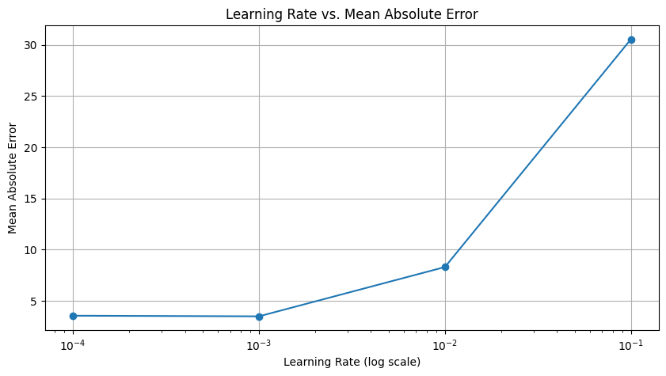
Graphical Plot of How Mean Absolute Error changes with Learning Rate

Slide 8
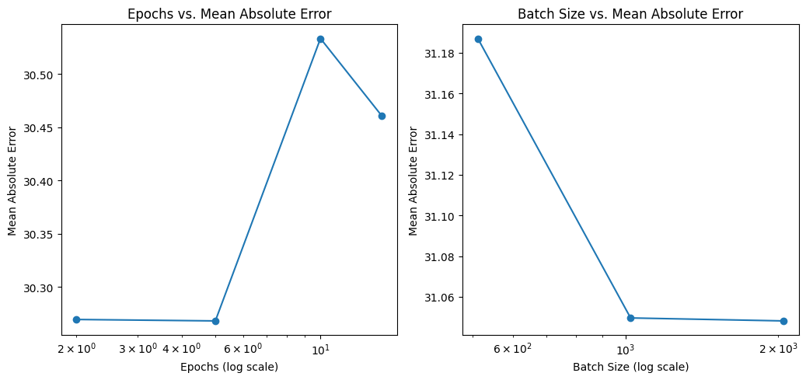
Graphical Plot of How Mean Absolute Error changes with Various Epochs and Batch Sizes

Slide 9
Testing and Validation
TEST CASE | GIVEN INPUT (Number of Epochs) | ACTUAL PRICE | PREDICTED PRICE | ACCURACY
1 | 50 (Google) | 1120 | 1143 | 97.9%
2 | 30 (amazon) | 90.34999847 | 90.55674 | 99.4%
3 | 100 (Google) | 1143.650024 | 1103.5631 | 96.26%
4 | 50 (Amazon) | 92.4199 | 92.5209 | 99.89%

Slide 10
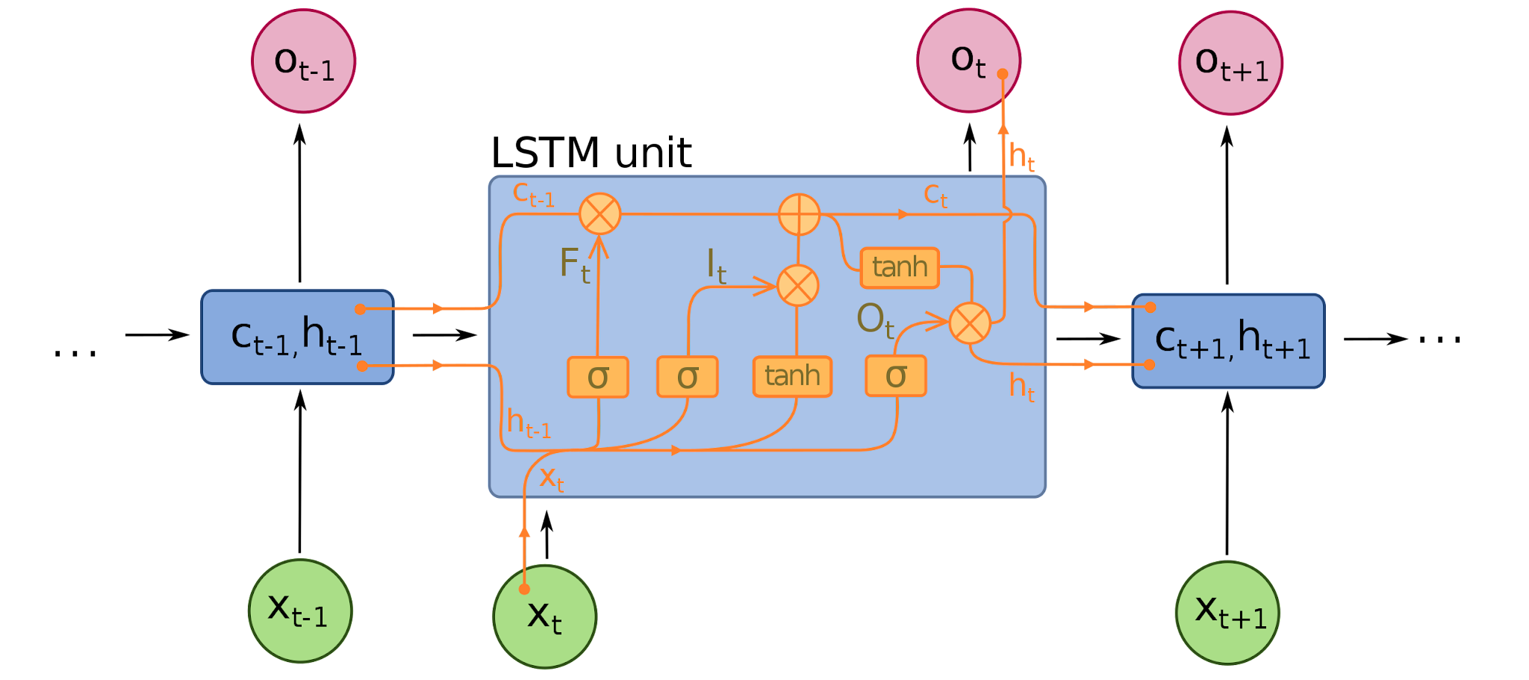
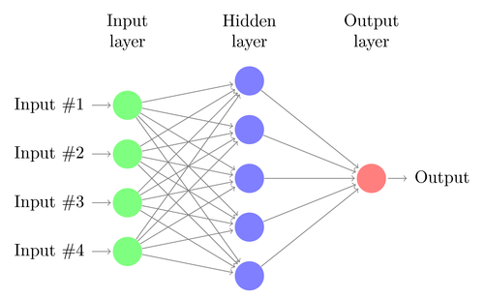
PROPOSED ARCHITECTURE
S.I.R.I.U.S. follows a robust architecture, encompassing data preprocessing, AI model creation, and prediction generation. The architecture consists of:
Forget Gate: LTM goes to forget gate and it forgets information that is not useful.
Learn Gate: Event ( current input ) and STM are combined together so that necessary information that we have recently learned from STM can be applied to the current input.
Remember Gate: LTM information that we haven’t forget and STM and Event are combined together in Remember gate which works as updated LTM.
Use Gate: This gate also uses LTM, STM, and Event to predict the output of the current event which works as an updated STM.

Slide 11
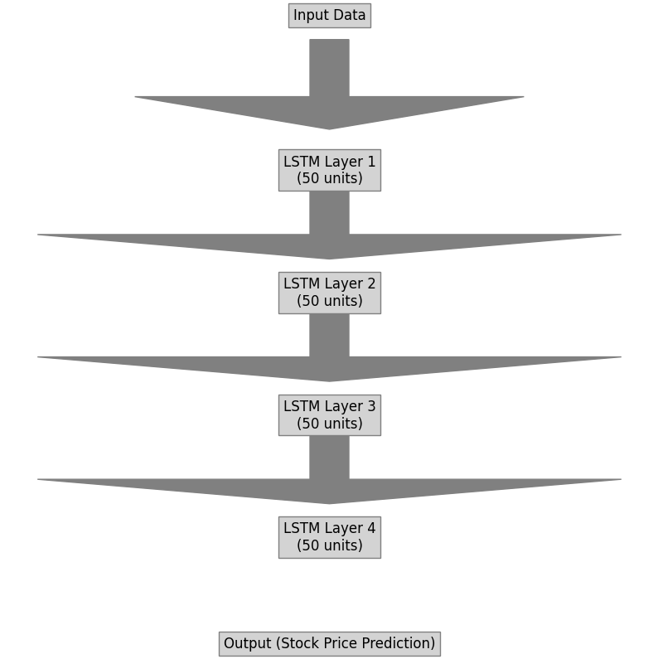
Architecture
_________________________________________________________________
Layer (type) Output Shape Param #
=================================================================
lstm_1 (LSTM) (None, 60, 50) 10400
_________________________________________________________________
dropout_1 (Dropout) (None, 60, 50) 0
_________________________________________________________________
dense_1 (Dense) (None, 60, 1) 51
=================================================================
Total params: 10,451
Trainable params: 10,451
Non-trainable params: 0
_________________________________________________________________

Slide 12

OPEN ISSUES
Data Quality and Reliability: Stock market data can be noisy and prone to errors. Inaccurate or incomplete data can lead to misleading predictions.
Overfitting: Avoid overfitting your model to historical data. Overfit models may not generalize well to unseen data, leading to poor real-world performance.
Changing Market Conditions: Stock markets are influenced by a wide range of factors, and market conditions can change rapidly. Model struggles to adapt to new conditions.

Slide 13
FUNCTIONAL AND NON-FUNCTIONAL REQUIREMENTS
S.I.R.I.U.S. is designed with several key requirements in mind. Functionally, it must be capable of real-time data processing from various sources, including financial market data streams, news outlets, and social media platforms. It should offer accurate prediction capabilities, aiding in identifying market trends. Furthermore, risk assessment is crucial, ensuring that investors are informed about potential pitfalls. Non-functionally, S.I.R.I.U.S. needs to be scalable to accommodate increasing data volumes, reliable to instill user confidence, and secure to protect sensitive financial information.
Functional requirements of S.I.R.I.U.S.:-
Real-time data processing
Prediction accuracy
Risk assessment
User-friendly interface
Scalability
Security
Non-functional requirements of S.I.R.I.U.S.:-
Reliability
Security
Availability
Maintainability
Usability

Slide 14
METHODOLOGY
Data Preprocessing
We use data preprocessing techniques to ensure data quality, handle missing values, and normalize features.
Model Selection and Training
Our methodology involves selecting and training a diverse set of machine learning models, including time series models, deep learning models, and LSTM.
Visualization
Graphical representation of data and results were done using MatPlotLib
Epoch-Error Analysis
An epoch- time analysis was done for various values of epochs

Slide 15
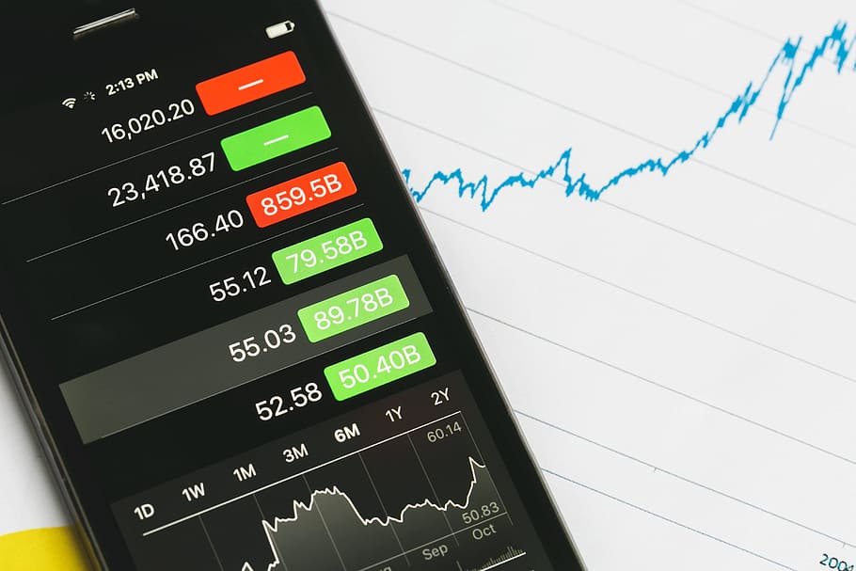
Progress in report so far
Firstly we created a LSTM (Long Short Term Memory) Model.
Then we created a dataset and then we moulded the dataset as per our model created.
We curated a new dataset and created the model on it.
Then we ran the model for different parameters.
Compared the results and analysed how the values were varying.
Did an epoch-error analysis

Slide 16
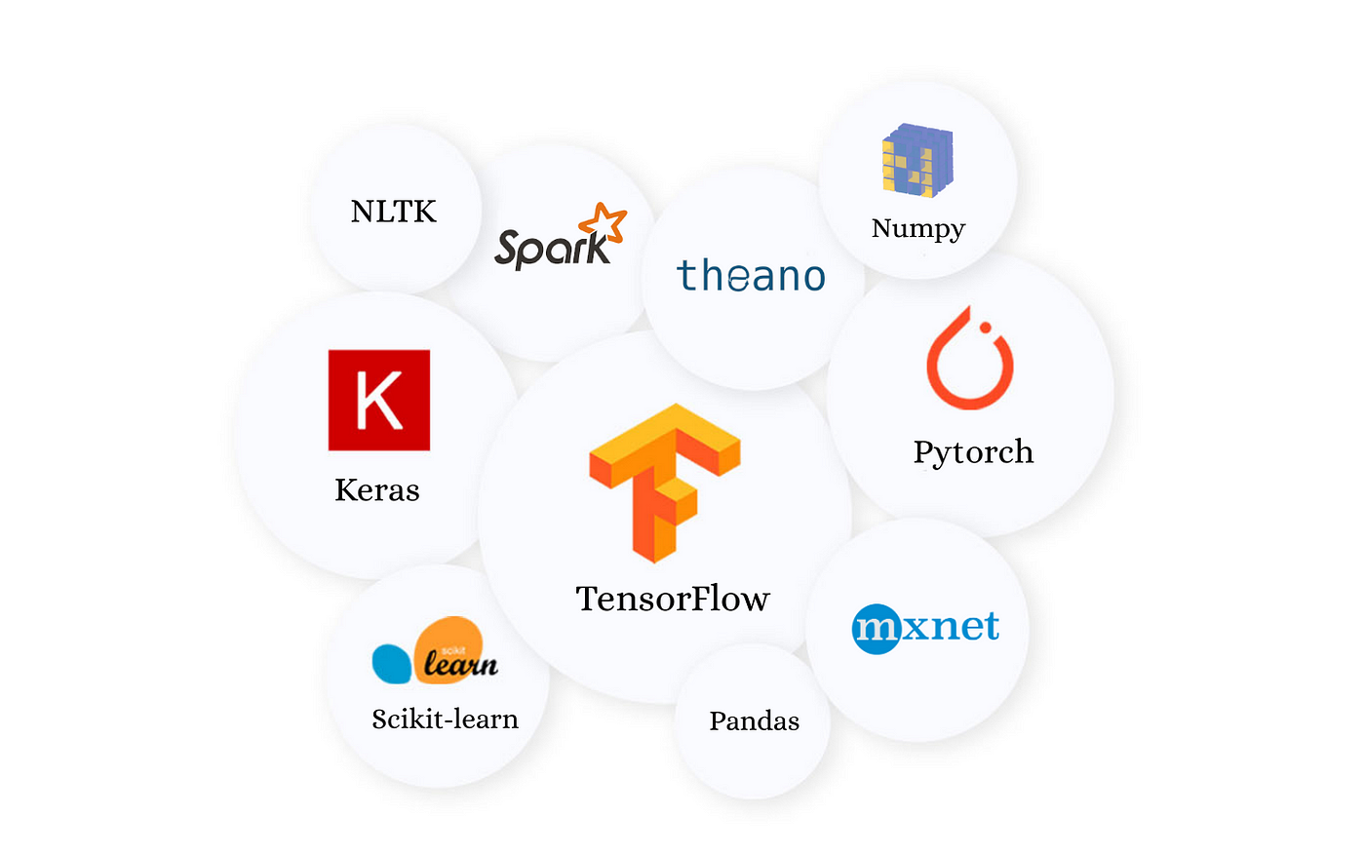
Tools And Technology
The foundation of S.I.R.I.U.S. lies in a carefully chosen set of tools and technologies. Python, a versatile programming language, is employed for its robust ecosystem and data analysis capabilities. TensorFlow and scikit-learn, popular machine learning libraries, form the backbone of predictive modeling.
TensorFlow: It is used for a variety of tasks, including image classification, natural language processing, and speech recognition.
scikit-learn: It is known for its ease of use and its wide range of features. scikit-learn is often used for tasks such as classification, regression, and clustering.
Keras: Keras is a high-level API for TensorFlow that makes it easy to build and train deep learning models.
PyTorch: PyTorch is often used for tasks such as image classification and natural language processing.
MatPlotLib: MatPlotLib is a comprehensive library for creating static, animated and interactive visualizations in Python.

Slide 17
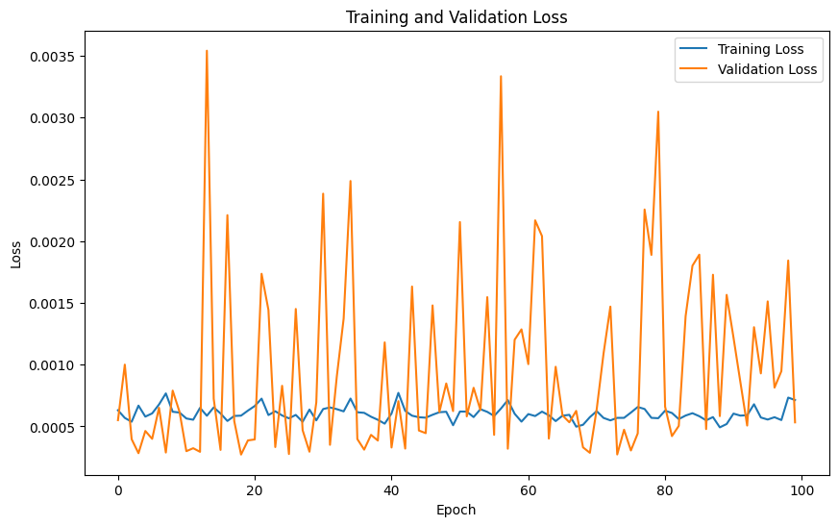
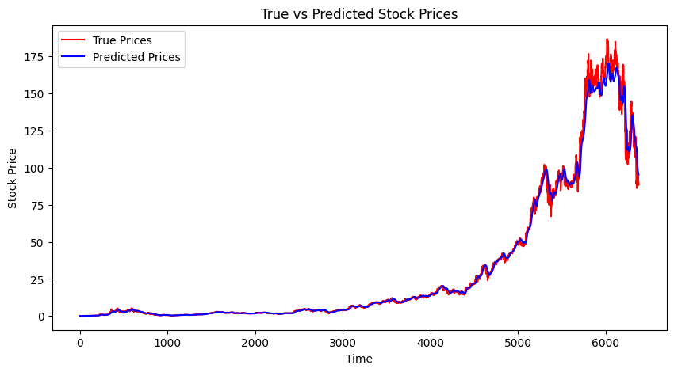
CONCLUSION
S.I.R.I.U.S. represents a significant advancement in stock market prediction. By amalgamating AI with financial markets, it offers investors a powerful tool for making informed decisions. The journey from conceptualization to implementation showcases the potential of AI in transforming investment strategies.

Slide 18
Suggestions / Questions
Please …

Slide 19
Thank you !

